Slide 1
Database Systems
Lecture 1-Chapter # 8
Relational algebra
Alina Arshad
alina.arshad@nu.edu.pk

Slide 2
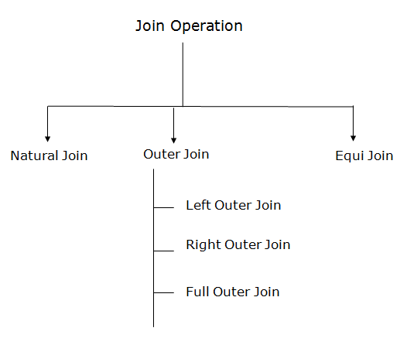
Types of Join Operations

Slide 3
Left Outer Join:
Left outer join contains the set of tuples of all combinations in R and S that are equal on their common attribute names.
In the left outer join, tuples in R have no matching tuples in S. It is denoted by ⟕.
Example: Using the EMPLOYEE table and Department table
Employee Dep
EmpID | Ename | DeptID
1 | John | 10
2 | Alice | 20
3 | Bob | 30
4 | Carol | NULL
DeptID | Dname
10 | Sales
20 | Marketing
40 | IT

Slide 4
Left Outer Join:
Input:
EMPLOYEE ⟕DeptID=DeptID Department
Output:
EmpID | Ename | DeptID (EMPLOYEE) | Dname
1 | John | 10 | Sales
2 | Alice | 20 | Marketing
3 | Bob | 30 | NULL
4 | Carol | NULL | NULL

Slide 5
Right Outer Join:
Right outer join contains the set of tuples of all combinations in R and S that are equal on their common attribute names.
In right outer join, tuples in S have no matching tuples in R. It is denoted by ⟖.
Example: Using the above EMPLOYEE table and Department Relation
Input: EMPLOYEE ⟖ DeptID=DeptID Department
Output:
EmpID | Ename | DeptID (DEPARTMENT) | Dname
1 | John | 10 | Sales
2 | Alice | 20 | Marketing
NULL | NULL | 40 | IT

Slide 6
Full Outer Join:
Full outer join is like a left or right join except that it contains all rows from both tables.
In full outer join, tuples in R that have no matching tuples in S and tuples in S that have no matching tuples in R in their common attribute name. It is denoted by ⟗.
Example: Using the above EMPLOYEE table and Department table
Input: EMPLOYEE ⟗ Department
Output:
EmpID | Ename | DeptID | Dname
1 | John | 10 | Sales
2 | Alice | 20 | Marketing
3 | Bob | 30 | NULL
4 | Carol | NULL | NULL
NULL | NULL | 40 | IT

Slide 7


Division ÷
Retrieve the names of employees who work on all the projects that ‘John Smith’ works on.
First retrieve the list of project numbers that ‘John Smith’ works on in
the intermediate relation SMITH_PNOS:
Next, create a relation that includes a tuple <Pno, ESSN>, whenever the employee whose SSN is ESSN works on the project whose number is PNO in the intermediate relation SSN_PNOS

Slide 8

Division
Finally apply the division operation, to the two relations, which gives the desired employees’ SSN

Slide 9
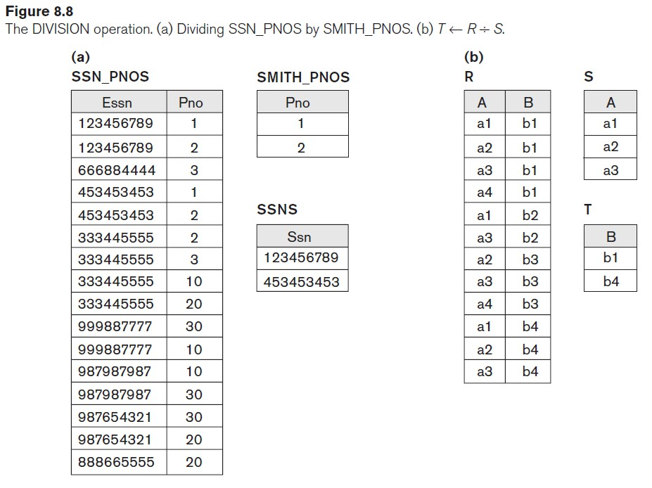

Slide 10
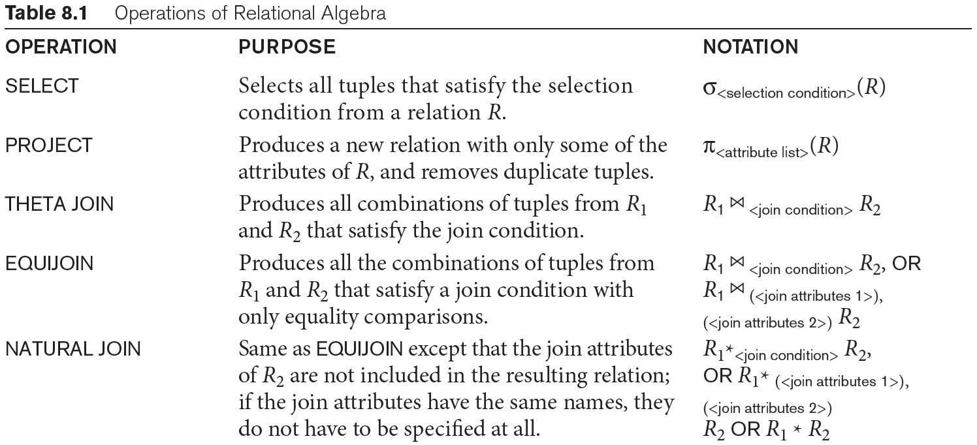
Table 8.1 Operations of Relational Algebra

Slide 11
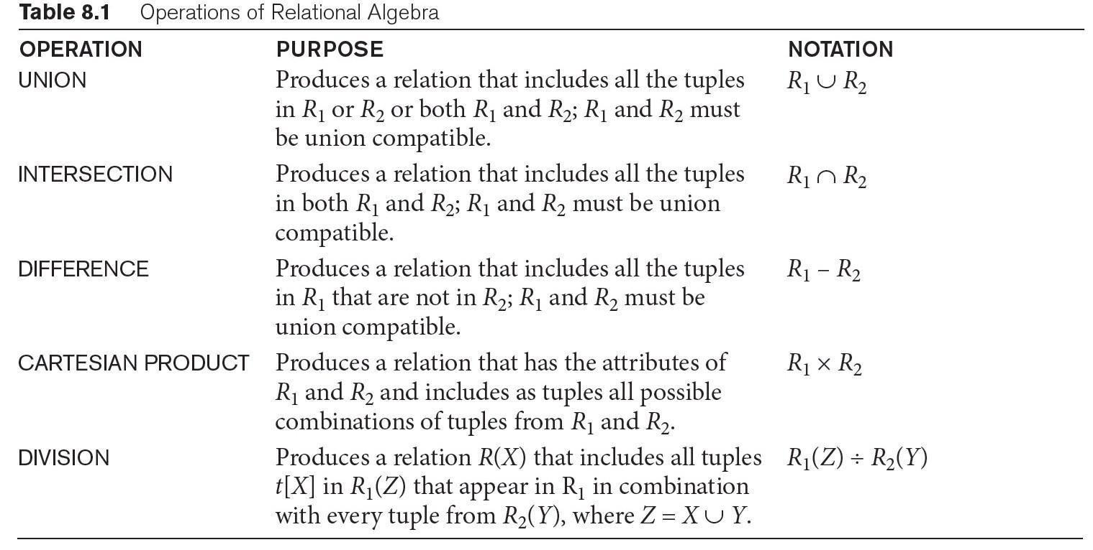
Table 8.1 Operations of Relational Algebra (continued)

Slide 12
Aggregate Function Operation
Use of the Aggregate Functional operation ℱ
ℱ_{MAX Salary} (EMPLOYEE) retrieves the maximum salary value from the EMPLOYEE relation
ℱ_{MIN Salary} (EMPLOYEE) retrieves the minimum Salary value from the EMPLOYEE relation
ℱ_{SUM Salary} (EMPLOYEE) retrieves the sum of the Salary from the EMPLOYEE relation
ℱ_{COUNT SSN, AVERAGE Salary} (EMPLOYEE) computes the count (number) of employees and their average salary
Note: count just counts the number of rows, without removing duplicates

Slide 13
Using Grouping with Aggregation
The previous examples all summarized one or more attributes for a set of tuples
Maximum Salary or Count (number of) Ssn.
Grouping can be combined with Aggregate Functions
Example: For each department, retrieve the DNO, COUNT SSN, and AVERAGE SALARY
A variation of aggregate operation ℱ allows this:
Grouping attribute placed to left of symbol
Aggregate functions to right of symbol
DNO ^{ℱ}COUNT SSN, AVERAGE Salary ^{(EMPLOYEE)}
Above operation groups employees by DNO (department number) and computes the count of employees and average salary per department

Slide 14
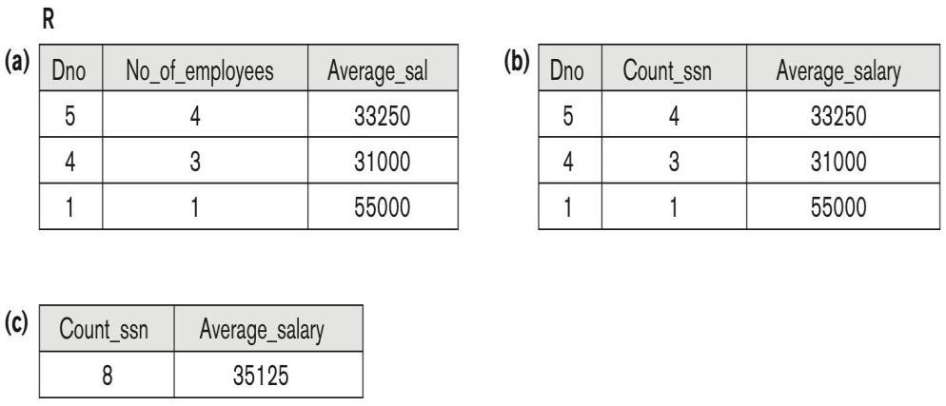
Figure 8.10: The aggregate function operation.
^{a) ρ}R(Dno, No_of_employees, Average_sal)⁽Dno ^{ℑ} COUNT Ssn, AVERAGE _{Salary} (EMPLOYEE)).
_{b) Dno} ℑCOUNT Ssn, AVERAGE Salary (EMPLOYEE).
^{c) ℑ} COUNT Ssn, AVERAGE Salary^{(EMPLOYEE).}

Slide 15
Examples of Queries in Relational Algebra
Q1: Retrieve the name and address of all employees who work for the ‘Research’ department.
RESEARCH_DEPT ← σ DNAME=’Research’ (DEPARTMENT)
RESEARCH_EMPS ← (RESEARCH_DEPT _{DNUMBER= DNOEMPLOYEE}EMPLOYEE)
RESULT ← π FNAME, LNAME, ADDRESS (RESEARCH_EMPS)
Single expression Form
π _{Fname, Lname, Address} (σ Dname= ‘Research’ (DEPARTMENT Dnumber=Dno(EMPLOYEE))

Slide 16
Examples of Queries in Relational Algebra
Query 2. For every project located in ‘Stafford’, list the project number, the controlling department number, and the department manager’s last name, address, and birth date.
STAFFORD_PROJS ← σPlocation=‘Stafford’(PROJECT)
CONTR_DEPTS ← (STAFFORD_PROJS Dnum=Dnumber DEPARTMENT)
PROJ_DEPT_MGRS ← (CONTR_DEPTS Mgr_ssn=Ssn EMPLOYEE)
RESULT ← πPnumber, Dnum, Lname, Address, Bdate(PROJ_DEPT_MGRS)

Slide 17
Examples of Queries in Relational Algebra
Query 3. Find the names of employees who work on all the projects controlled by department number 5.
DEPT5_PROJS ← ρ (Pno)( π Pnumber( σ Dnum=5 (PROJECT)))
EMP_PROJ ← ρ(Ssn, Pno)(πEssn, Pno(WORKS_ON))
RESULT_EMP_SSNS ← EMP_PROJ ÷ DEPT5_PROJS
RESULT ← πLname, Fname(RESULT_EMP_SSNS * EMPLOYEE)

Slide 18
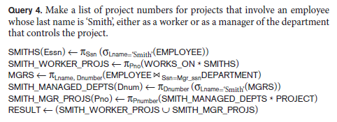
Examples of Queries in Relational Algebra

Slide 19
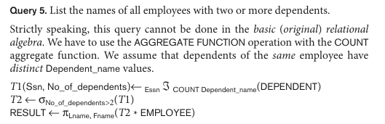
Examples of Queries in Relational Algebra

Slide 20
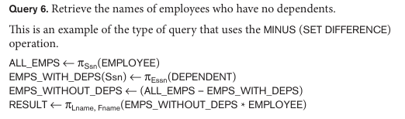
Examples of Queries in Relational Algebra

Slide 21
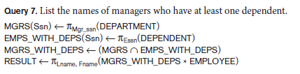
Examples of Queries in Relational Algebra

